Slide 1
Lists and collections
Simeon Angelov

Slide 2
Content
Collection
List and ArrayList
Facts for the quiz

Slide 3
Collection
An objects storing group of objects
Could be thought as a bag of many objects/instance from one and same type
Collection is an interface in java defining a collection https://docs.oracle.com/javase/8/docs/api/java/util/Collection.html
Contains methods being implemented by each concrete collection in java

Slide 4
ArrayList
A collection in java
Uses a dynamic array for storing the elements
There is no size limit – means we can decrease or increase the elements being stored
Could have also duplicate elements
Maintains insertion order - means the elements are sorted and positioned
Works at index bases – elements are accessed via index
ArrayList can not be used for primitive types, like int, char, etc. We need a wrapper class for for such cases.

Slide 5
ArrayList
Collection
Java class ArrayList implements interface List
Where interface List extends interface Collection
List
ArrayList

Slide 6
ArrayList
Syntax
ArrayList<Data_Type> array_name = new ArrayList<>();
or
ArrayList<Data_Type> array_name = new ArrayList<Data_Type>();
or
List<Data_Type> array_name = new ArrayList<>();
Example:
ArrayList<String> names = new ArrayList<>();
NOT
ArrayList<String> array = new List<>(); List in interface!

Slide 7
ArrayList
Syntax:
ArrayList bagOfAnything = new ArrayList<>();
Means the elements in the array are from any type
bagOfAnything.add(1);
bagOfAnything.add(“Peter”);
bagOfAnything.add(2.8);

Slide 8
ArrayList
Constructors
ArrayList<>();
ArrayList<>(int initialCapacity);
ArrayList<>(Collection initialState);
Examples:
ArrayList l1 = new ArrayList();
List l2 = new ArrayList(40);
ArrayList l3 = new ArrayList(l2);

Slide 9

ArrayList
ArrayList<String> fruits = new ArrayList<>();
apple | banana
Size of the array is 2
Default capacity is 10
fruits.add(“lemon”); will add a new string ”lemon” at position 2

Slide 10
ArrayList
Some used methods
void add(int index, E element)
boolean add(E e)
boolean addAll(Collection<? extends E> c)
void clear()
E get(int index)
boolean isEmpty()
Object[] toArray()
int indexOf(Object o)
E remove(int index)
boolean remove(Object o) – where calls o.equals() method for checking of the Object is the list!
E set(int index, E element)
int size()

Slide 11
ArrayList
boolean add(E element); void add(int index, E element);
Remember when you do have typed array and NOT typed array:
ArrayList list = new ArrayList();
ArrayList<String> list2 = new ArrayList<>();
list.add(“hey”);
list.add(Integer.valueOf(1)); OK
list.add(”hey");
list.add(Integer.valueOf(1)); NOT OK, compilation error

Slide 12
ArrayList
boolean add(E element); void add(int index, E element);
List<String> numbers = new ArrayList<>();
numbers.add(”One"); -> [One] numbers.add(1, ”Five"); -> [One, Five] numbers.add(0, ”Seven"); -> [Seven, One, Five]
numbers.add(1, ”Two"); -> [Seven, Two, One, Five]

Slide 13
ArrayList
boolean remove(Object object)
Remove the object if exists in the array
Return true if the object is removed, false otherwise
Uses equals(Object obj) method to identify if object is part of the collection/ArrayList or not
E remove(int index)
Remove object at specified position and shifts the others
Returns the removed object
Throws IndexOutOfBoundException if index is bigger than the size of array
List<String> numbers = new ArrayList<>(); numbers.add(”One");
numbers.add(”Two”);
System.out.println(numbers.remove(”One"));
System.out.println(numbers.remove(”3")); -> false

Slide 14
ArrayList
E set(int index, E newElement)
Change the element at position index
Does NOT change the size of the array
List<String> numbers = new ArrayList<>(); numbers.add("One"); numbers.set(0, "Two"); numbers.set(1, "Three"); -> IndexOutOfBoundsException

Slide 15
void clear()
Clears the elements of the array
E get(int index)
- Get the element at position index
boolean isEmpty()
Returns true if the array has not elements
Object[] toArray()
Return an array representation of the elements of the array list
boolean contains(Object object)
- Returns true when the element is in the array list

Slide 16
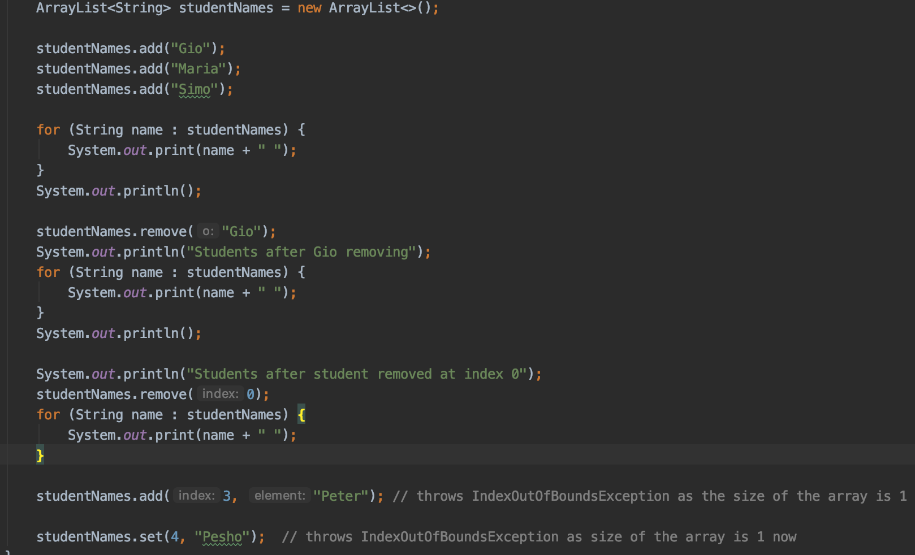
ArrayList

Slide 17
ArrayList
Iterator
ArrayList iterator() method returns an iterator to access each element of the arraylist in a proper sequence.
Syntax :
arraylist.iterator()
Functions:
hasNext() – shows if there is next element
next() - return the current element and move the iterator to point to the next element
remove() – remove the current element

Slide 18
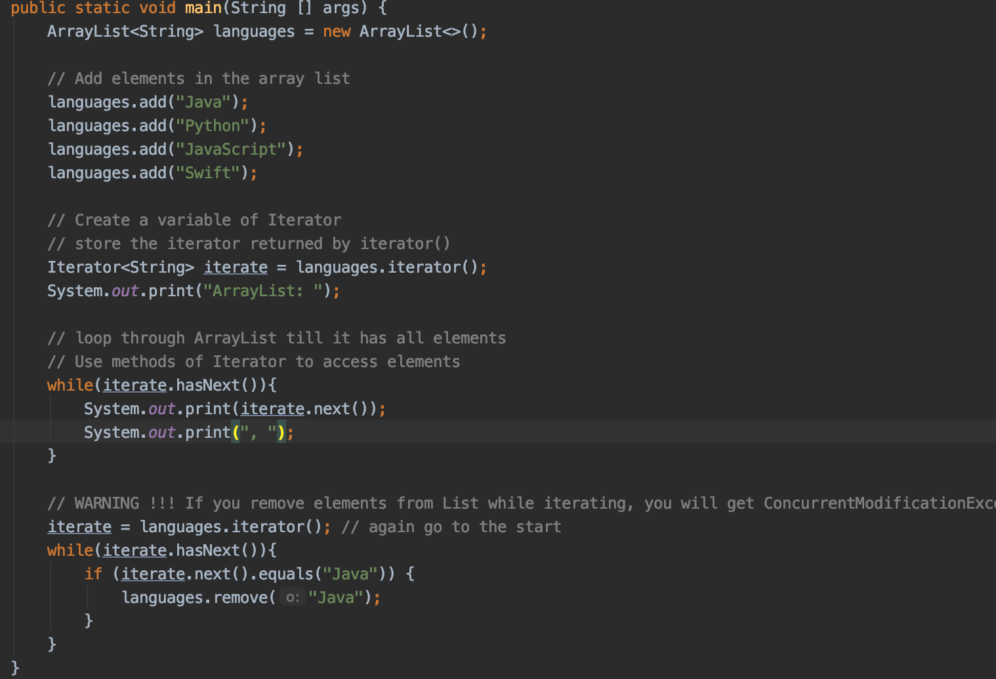
ArrayList

Slide 19
ArrayLIst
Demo -> java_arraylist_10_demos

Slide 20
Facts for the quiz
ArrayList stores dynamically sized collection of elements
Internally uses an array to store the elements
Java ArrayList allows duplicate and null values.
Java ArrayList is an ordered collection
You cannot create an ArrayList of primitive types like int, char etc. You need to use boxed types like Integer, Character, Boolean etc.
boolean remove(Object o) - removes the element with the lowest index i such that (o==null ? get(i)==null : o.equals(get(i))). So uses equals() method for removing of an element
removeIf(Predicate p): removes all elements applying given predicate

Slide 21
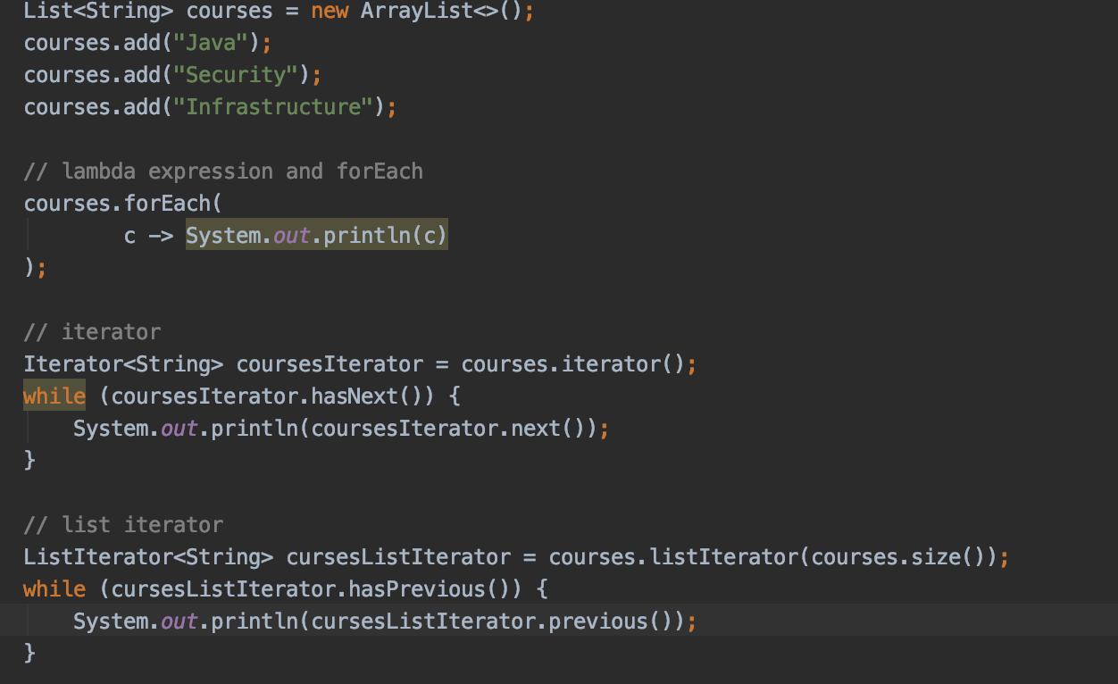
Facts for the quiz
Iterating via
forEach
Iterator() and forEachRemaining() against the iterator
listIterator().
Simple for-each loop.
for loop with index.

Slide 22
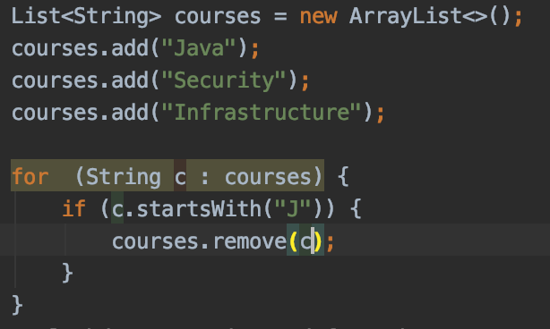
Facts for the quiz
While iteration an ArrayList you can remove element from the list only via iterator , not via the ArrayList instance itself. Otherwise ConcurrentModificationException is thrown

Slide 23
Exercises

Slide 24
Questions?
Notes:
Do you have any questions?

Slide 25
Thank You For Your Time

